Slide 1
Genética Molecular em Análises Clinicas
A Transcrição

Slide 2
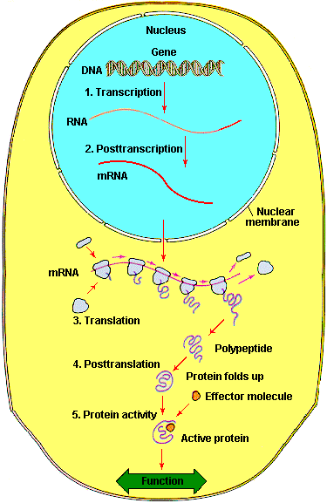

Slide 3
A Transcrição
O RNA como espécie central na genética
Tipos de polimerases do RNA. Cofactores
Promotores
Mecanismo da Transcrição
Papel da instabilidade do RNA.
Transcrição reversa

Slide 4
O RNA no cerne da Genética
Transcrição
produção de mRNA
A regulação génica depende da semivida do mRNA
Primers de RNA na replicação
O tRNA intervem na tradução
O rRNA intervem na tradução
Alguns vírus só utilizam o RNA

Slide 5
A Transcrição
O RNA como espécie central na genética
Tipos de polimerases do RNA. Cofactores
Promotores
Mecanismo da Transcrição
Papel da instabilidade do RNA.
Transcrição reversa

Slide 6
Polimerases do RNA
Eucariotas:
Tipo I – rRNA (50-70%)
Tipo II – hnRNA (20-40%; mRNA)
Tipo III – restantes espécies de RNA (10%;tRNA, snRNA)
Mitocondrias
Cloroplastos
Formadas por várias subunidades com funções específicas

Slide 7
A Transcrição
O RNA como espécie central na genética
Tipos de polimerases do RNA. Cofactores
Promotores
Mecanismo da Transcrição
Papel da instabilidade do RNA.
Transcrição reversa

Slide 8
Promotores

Slide 9
A Transcrição
O RNA como espécie central na genética
Tipos de polimerases do RNA. Cofactores
Promotores
Mecanismo da Transcrição
Papel da instabilidade do RNA.
Transcrição reversa

Slide 10
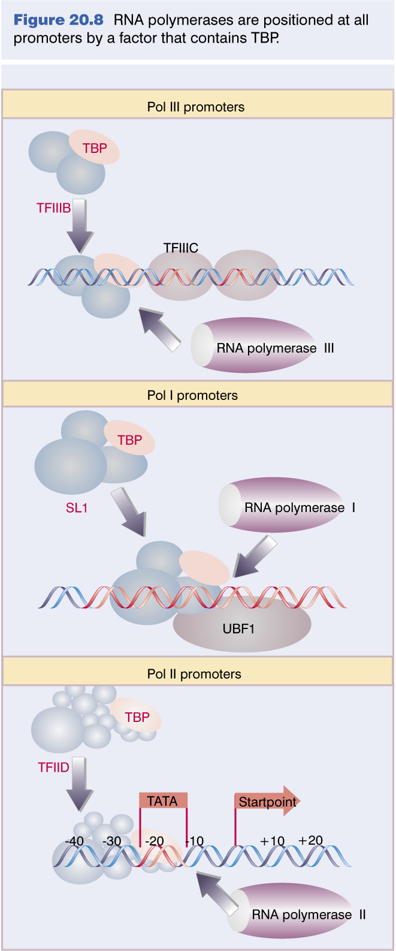
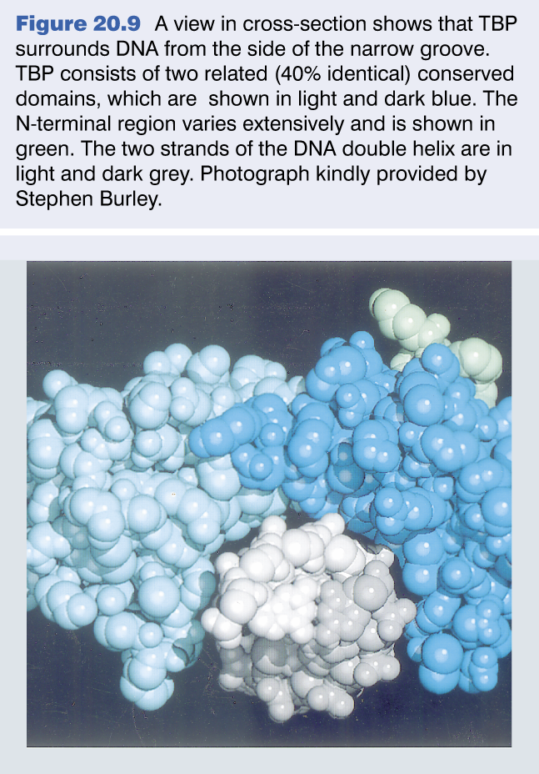
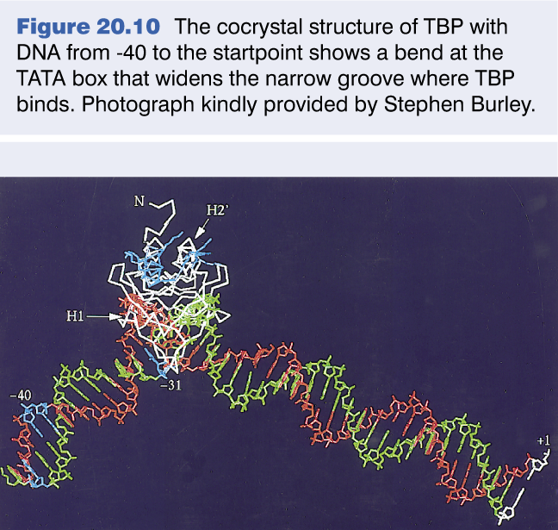
Pol é posicionada por TBP

Slide 11
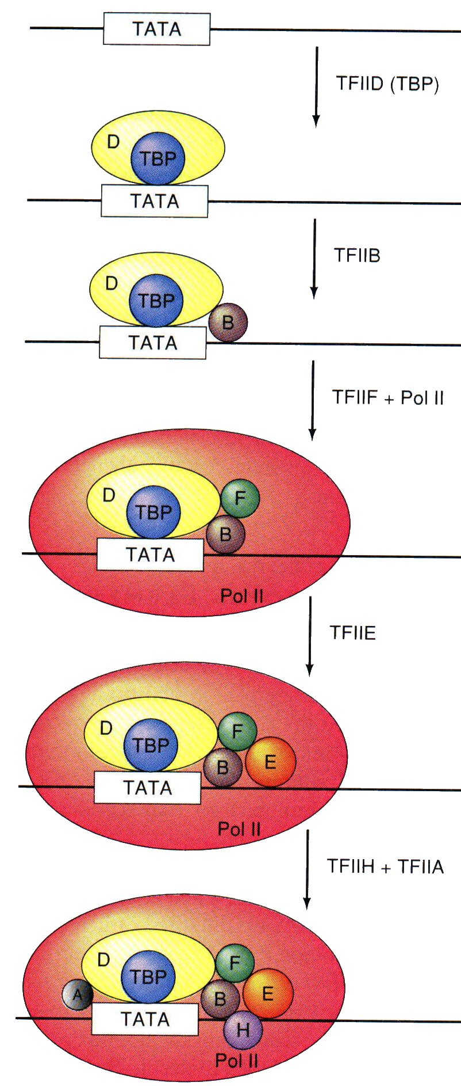
Iniciação da transcrição
animação

Slide 12
Abertura da hélice

Slide 13
Transcrição (animação)
Fase de iniciação
Reconhecimento do DNA e posicionamento
Abertura da hélice
Incorporação do primeiro nucleótido
Fase de elongação
Migração da zona de DNA aberto
Elongação do hnRNA
Fase de terminação

Slide 14
Transcrição
Processamento do RNA (animação)
Adição do CAP
Poliadenilação
splicing

Slide 15
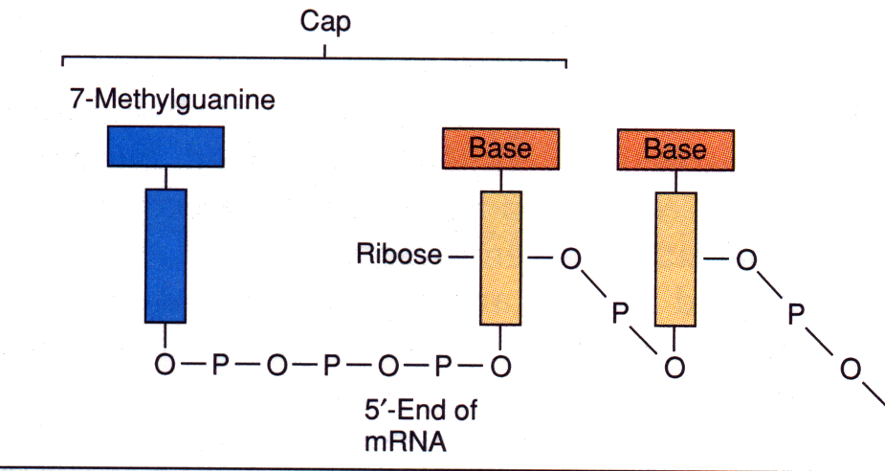
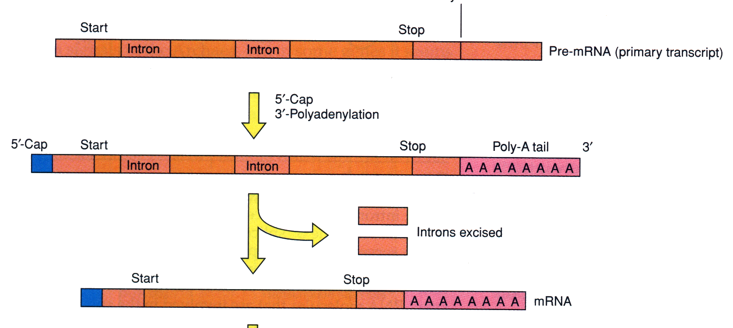
mRNA
animação

Slide 16
A Transcrição
O RNA como espécie central na genética
Tipos de polimerases do RNA. Cofactores
Promotores
Mecanismo da Transcrição
Papel da instabilidade do RNA.
Transcrição reversa

Slide 17
A Transcrição
O RNA como espécie central na genética
Tipos de polimerases do RNA. Cofactores
Promotores
Mecanismo da Transcrição
Papel da instabilidade do RNA.
Transcrição reversa

Slide 18
Regulation of Transcription Initiation

Slide 19
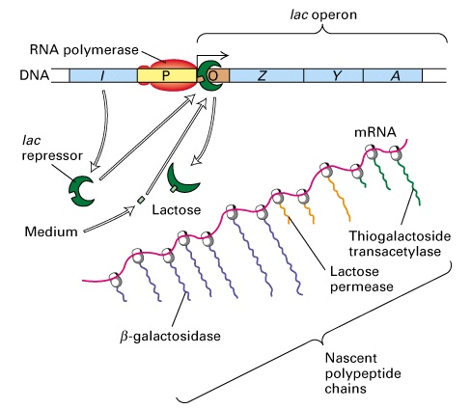
Bacterial gene control: the Jacob-Monod model

Slide 20
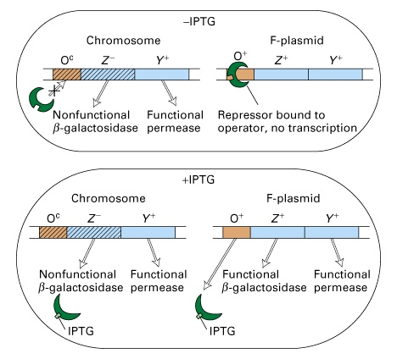
Experimental evidence for cis-acting DNA sequences

Slide 21
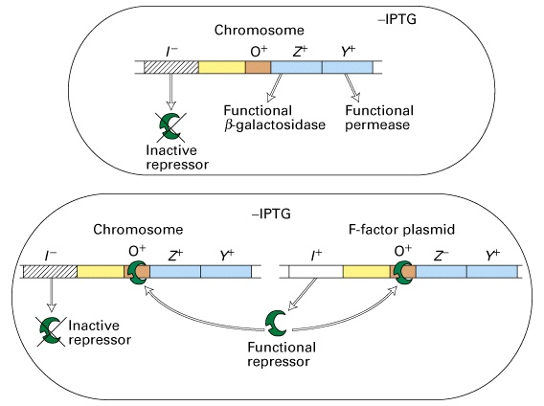
Experimental evidence for trans-acting genes/proteins

Slide 22
Bacterial transcription initiation
RNA polymerase initiates transcription of most genes at a unique DNA position lying upstream of the coding sequence
The base pair where transcription initiates is termed the transcription-initiation site or start site
By convention, the transcription-initiation site in the DNA sequence is designated +1, and base pairs extending in the direction of transcription (downstream) are assigned positive numbers which those extending in the opposite direction (upstream) are assigned negative numbers
Various proteins (RNA polymerase, activators, repressors) interact with DNA at or near the promoter to regulate transcription initiation

Slide 23
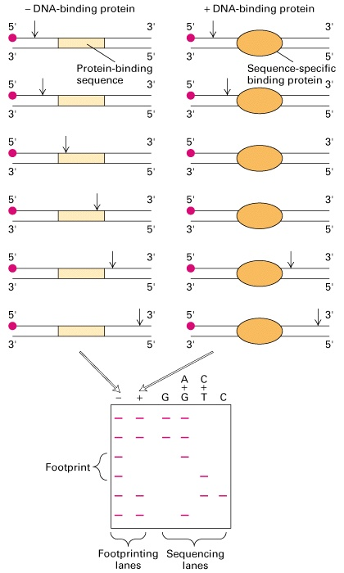
DNase I footprinting assays identify protein-DNA interactions

Slide 24
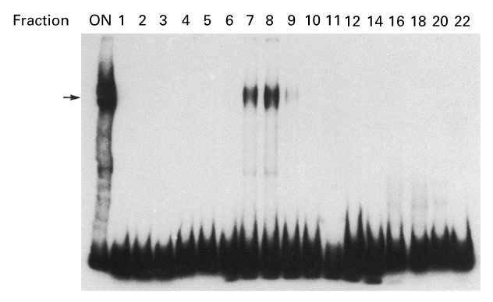
Gel-shift assays identify protein-DNA interactions

Slide 25
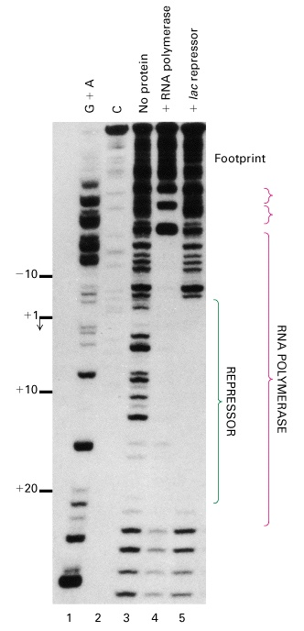
The footprint of RNA polymerase and lac repressor on the lac control region

Slide 26
The lac control region contains three critical cis-acting sites

Slide 27
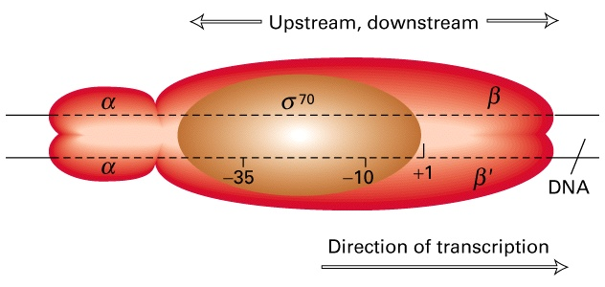
RNA polymerase binds to specific promoter sequences to initiate transcription
Each subunit has a specific function

Slide 28
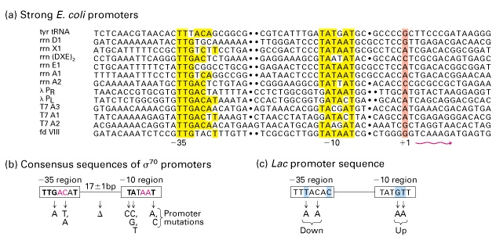
Differences in E. coli promoter sequences affect the frequency of transcription initiation

Slide 29
Most operator sequences are short inverted repeats
The lac operator

Slide 30
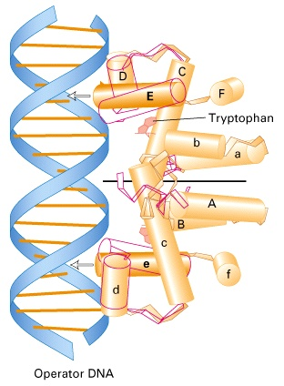
Ligand-induced conformational changes alter affinity of many repressors for DNA
Tryptophan binding induces a conformational change in the trp aporepressor

Slide 31
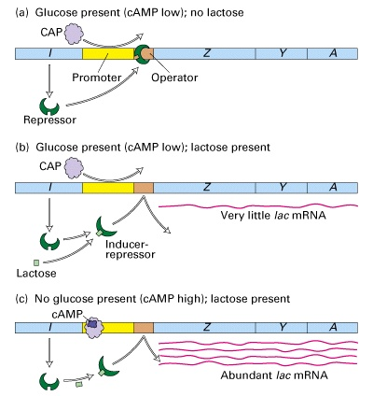
Positive control of the lac operon is exerted by cAMP-CAP
CAP = catabolite
activator protein

Slide 32
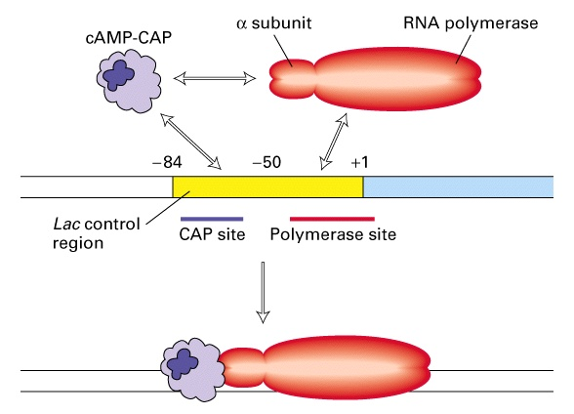
Cooperative binding of cAMP-CAP and RNA polymerase to the lac contol region activates transcription

Slide 33
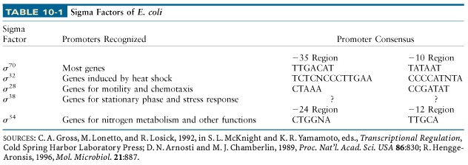
Transcription from some promoters is initiated by alternative sigma (σ) factors

Slide 34
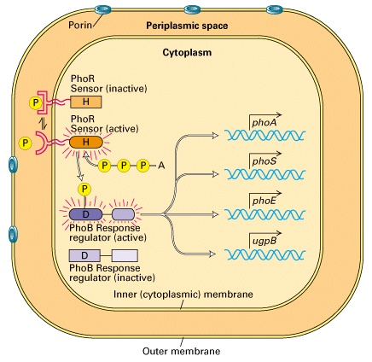
Many bacterial responses are controlled by two-component regulatory systems
The PhoR/PhoB two-component regulatory system in E. coli

Slide 35
Eukaryotic gene control: purposes and general principles
Unlike bacterial cells and most single cell eukaryotes, cells in multicelular organisms have relatively few genes that are reversibly regulated by environmental conditions
However, gene control in multicellular organisms is important for development and differentiation, and is generally not reversible

Slide 36
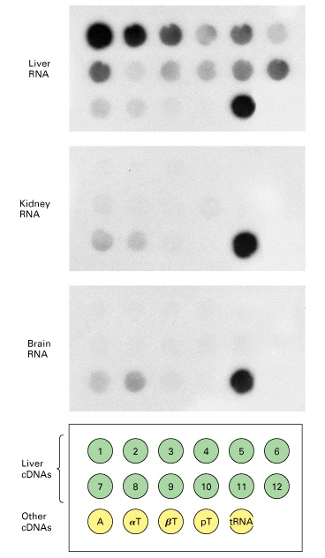
Differential synthesis of 12 mRNAs encoding liver-specific genes

Slide 37
Regulatory elements in eukaryotic DNA often are many kilobases from start sites
The basic principles that control transcription in bacteria also apply to eukaryotic organisms: transcription is initiated at a specific base pair and is controlled by the binding of trans-acting proteins (transcription factors) to cis-acting regulatory DNA sequences
However, eukaryotic cis-acting elements are often much further from the promoter they regulate, and transcription from a single promoter may be regulated by binding of multiple transcription factors to alternative control elements
Transcription control sequences can be identified by analysis of a 5′-deletion series

Slide 38
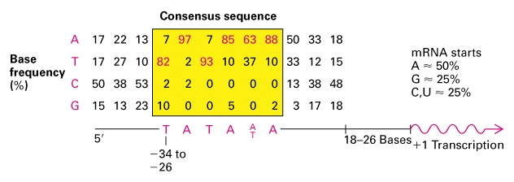
The TATA box is a highly conserved promoter in eukaryotic DNA
Alternative promoters in eukaryotes include initiators and CpG islands
5’-YYA⁺¹N-T/A-YYY-3’ (Y=C/T)

Slide 39
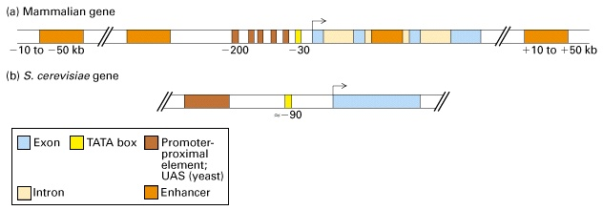
Most eukaryotic genes are regulated by multiple transcription control mechanisms

Slide 40
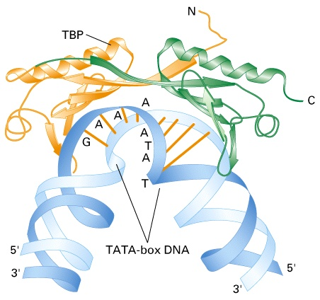
The conserved C-terminal domain of TBP binds to TATA-box DNA
TBP is a subunit of TFIID

Slide 41
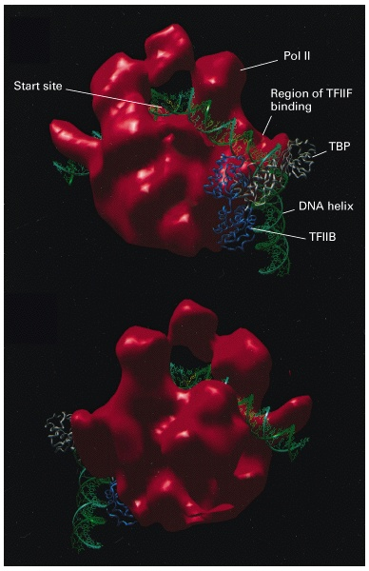
Structural model of the complex of promoter DNA, TBP, TFIIB, and Pol II

Slide 42
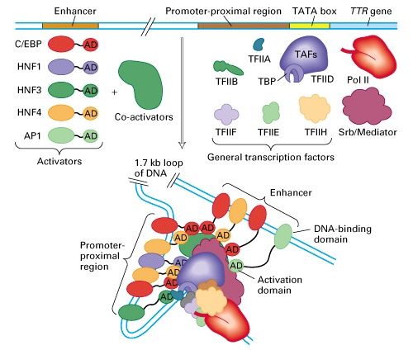
Model for cooperative assembly of an activated transcription-initiation complex in the TTR promoter

Slide 43
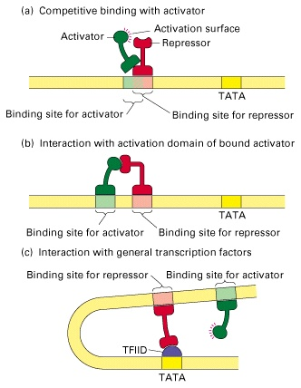
Repressors interfere directly with transcription initiation in several ways

Slide 44
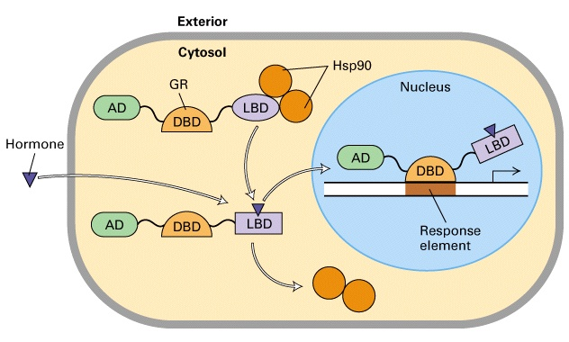
Model of hormone-dependent gene activation by the glucocorticoid receptor

Slide 45
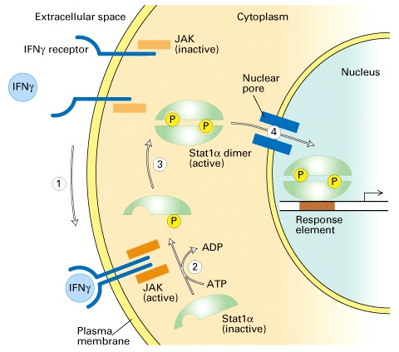
Polypeptide hormones signal phosphorylation of some transcription factors
Model of IFNγ-mediated gene activation by phosphorylation and dimerization of Stat1α

