Slide 1
Técnicas de Estudo em Genética

Slide 2
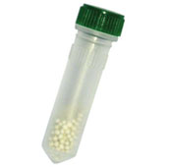
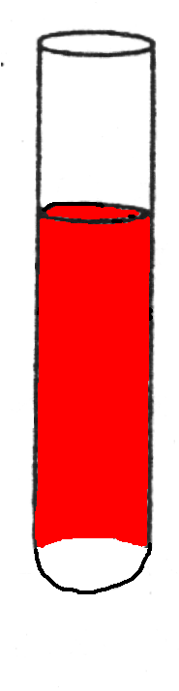
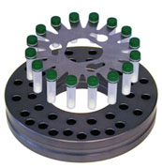

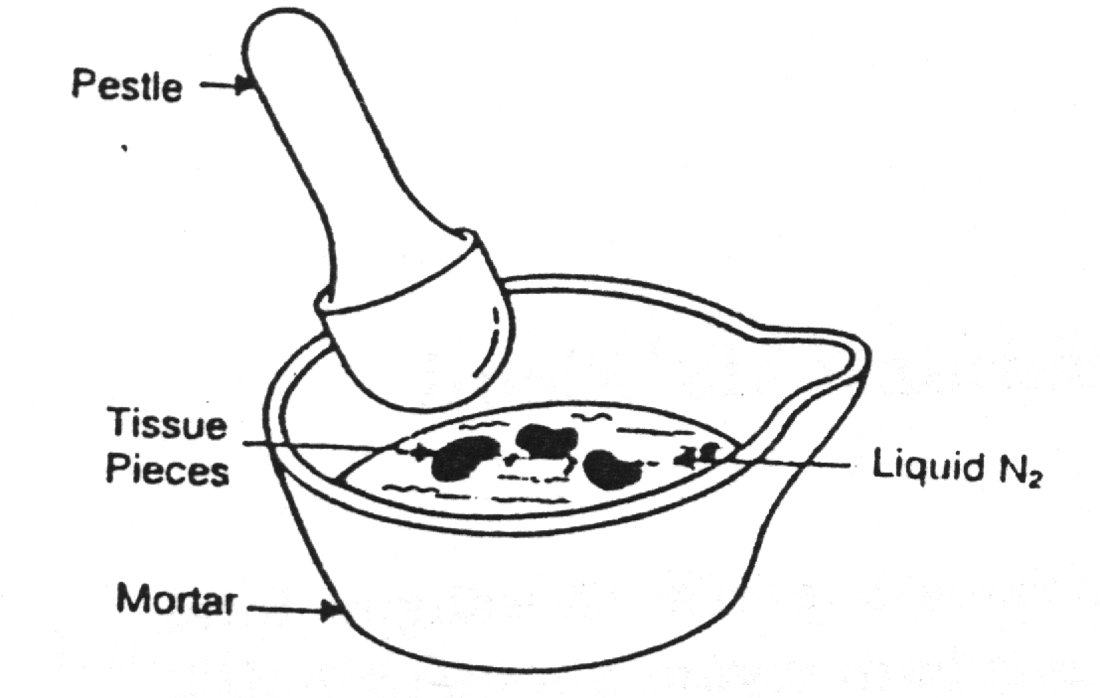
Preparação das células:
Pulverização após congelação
Lise de
eritrócitos
Cent.
Grad.
densidade
Maceração
mecânica

Slide 3
PREPARAÇÃO DE DNA E RNA
DNA e RNA de mamiferos:
  Lise suave e solubilização do DNA/RNA
  Destruição enzimática das proteínas (proteases)
  Destrição e precipitação quimica das proteínas (fenol/clorofómio/ácido isoamilico)
  Precipitação dos ácidos nucleicos (Acetato de amónio / Acetato de sódio / Cloreto de sódio)
  Redissolução dos ácidos nucleicos (prévia remoção de sais)

Slide 4
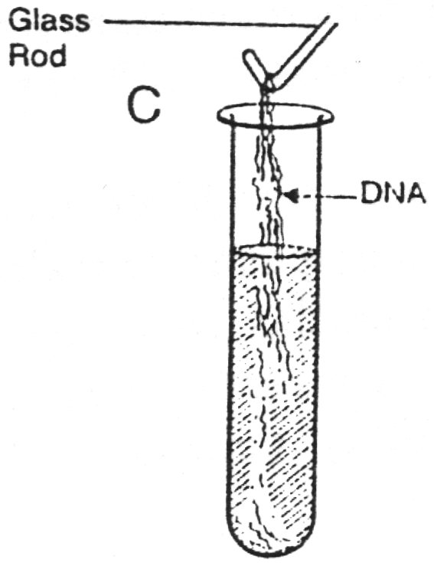
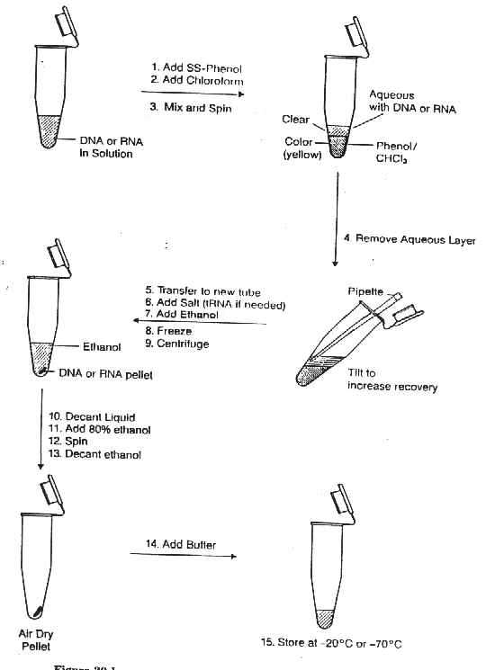
Método do fenol/CHCl₃
salting-out

Slide 5
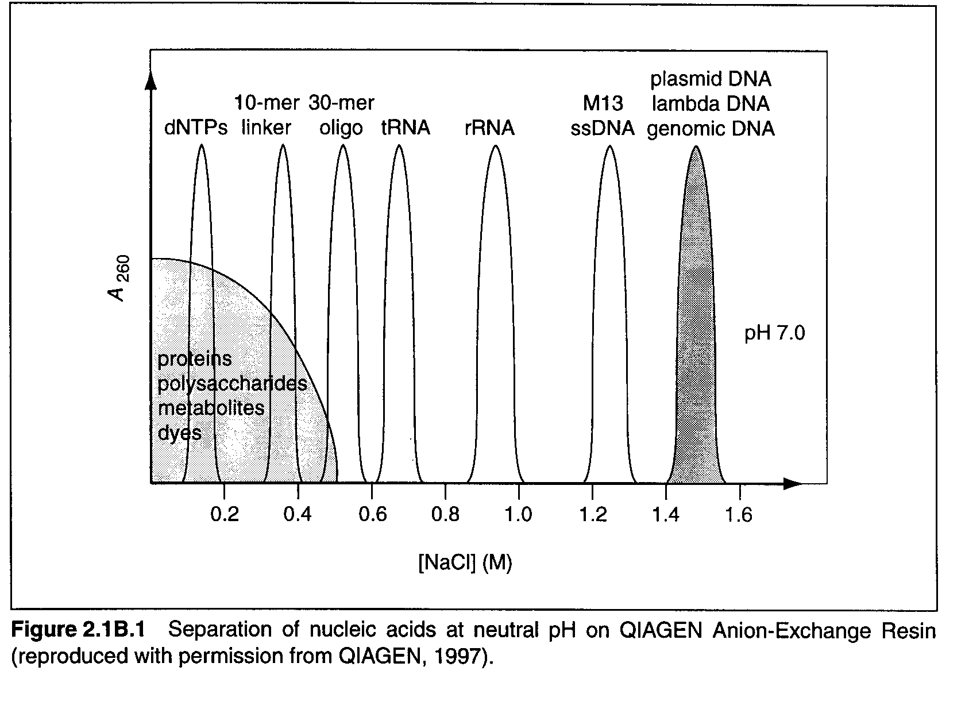
Separação de ácidos nucleicos por cromatografia de troca iónica

Slide 6
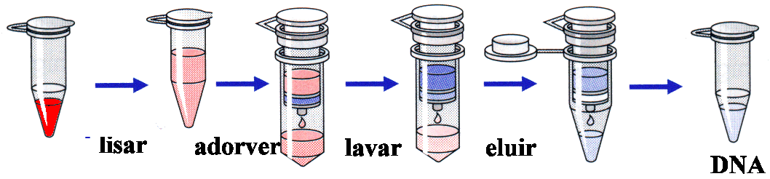
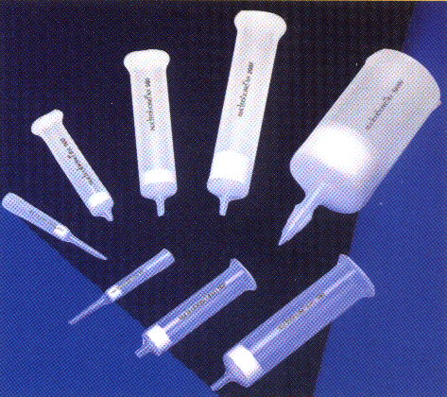
Colunas de sílica (ex. Qiagen)

Slide 7
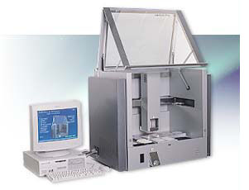
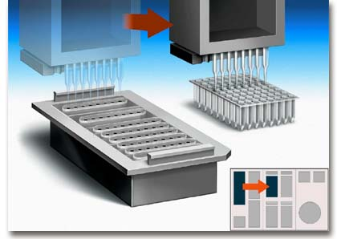
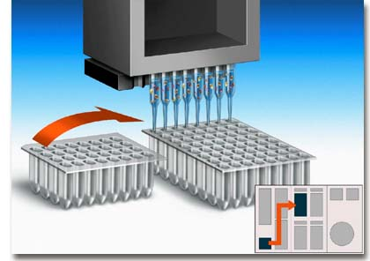
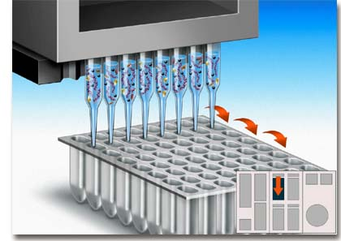
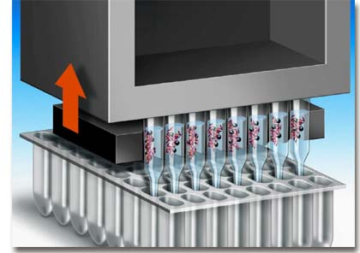
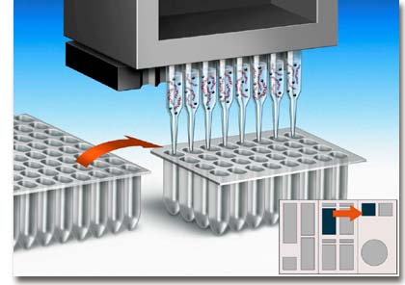
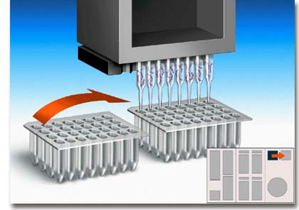
Sílica Magnética e automatização

Slide 8
Quantificação e caracterização de ácidos nucleicos
  Espectrofotometria
  Electroforese
  Reacções de restrição
    Sistemas R/M
    Montar uma reacção de restrição

Slide 9
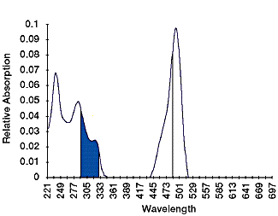
Espectrofotometria
Lei de Bert-Lambert
  C=εA
λmax
L=1 cm
A(suporte)
A(solvente)

Slide 10
Espectofotometria
λ_{max}=260 nm
λ_{max(proteínas)} =280 nm
λ_{ref} =320 nm
Concentração = f(OD₂₆₀). Se L=1cm:
  dsDNA 1OD=50µg/ml
  ssDNA 1OD=40µg/ml
  ssRNA 1OD=40µg/ml
  Oligos 1OD=20µg/ml (varia muito com a sequência)

Slide 11
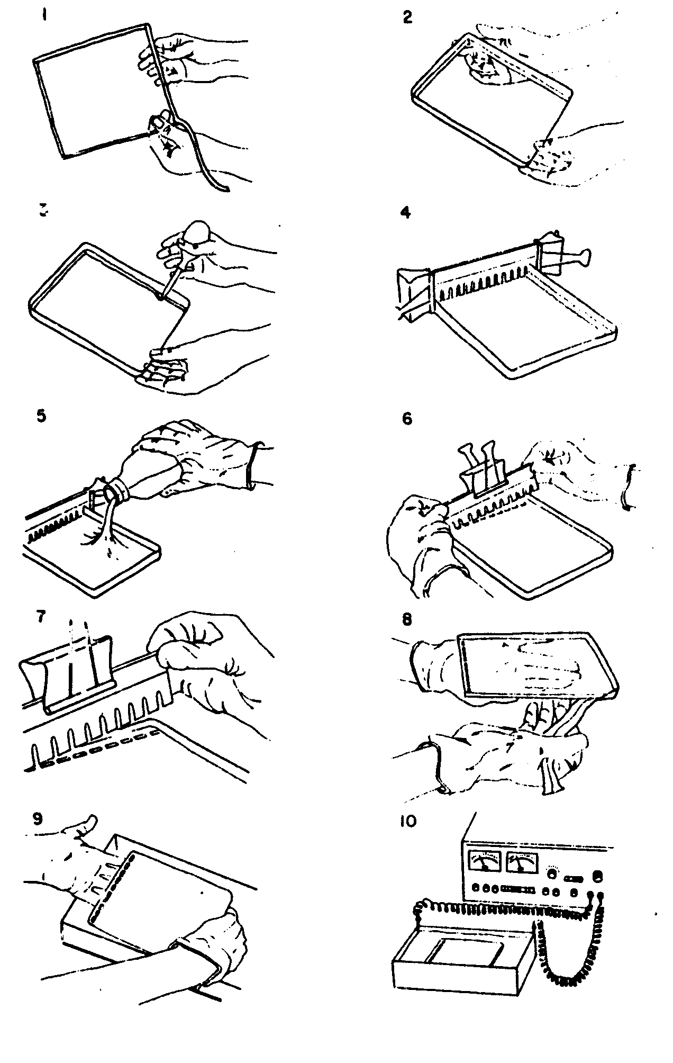
Fazer um gel de agarose

Slide 12
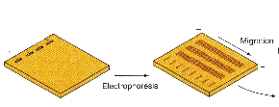
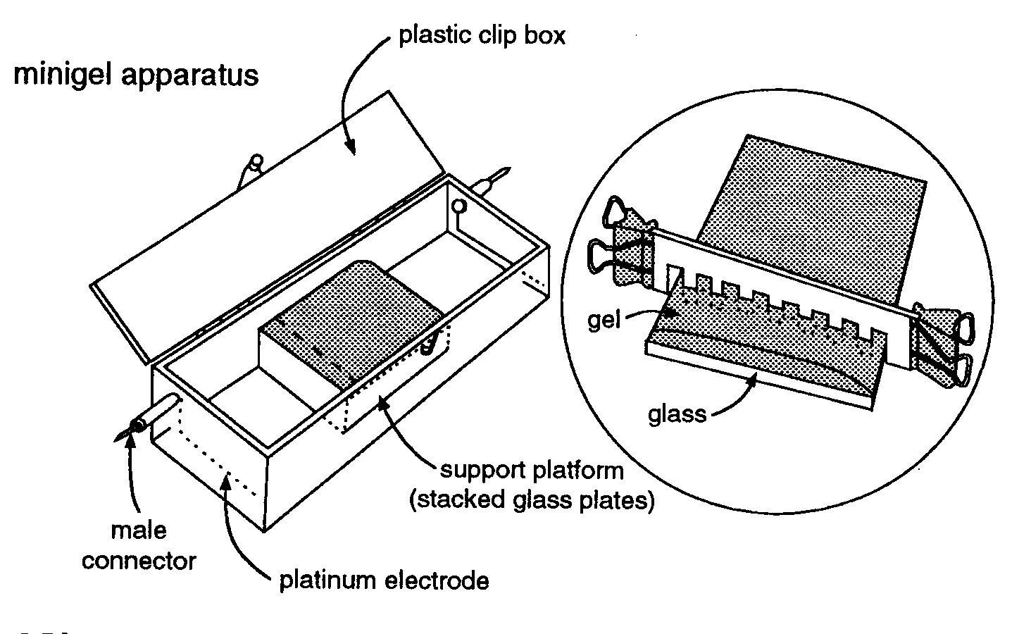
Electroforese

Slide 13
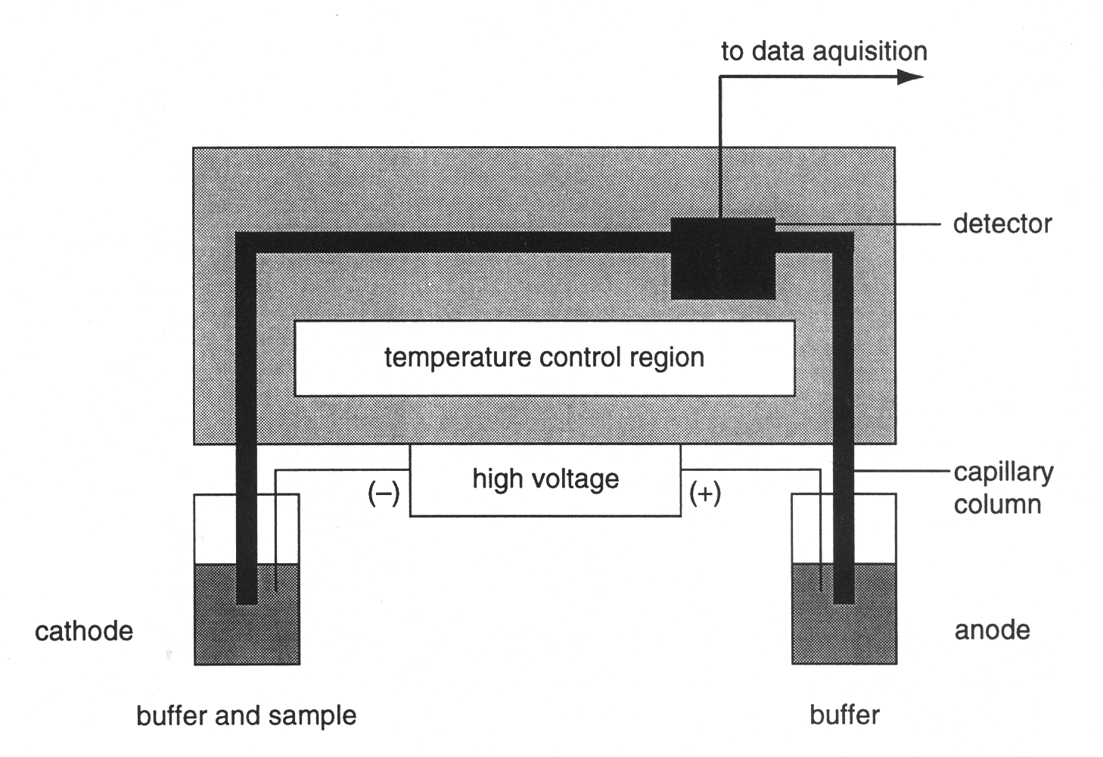
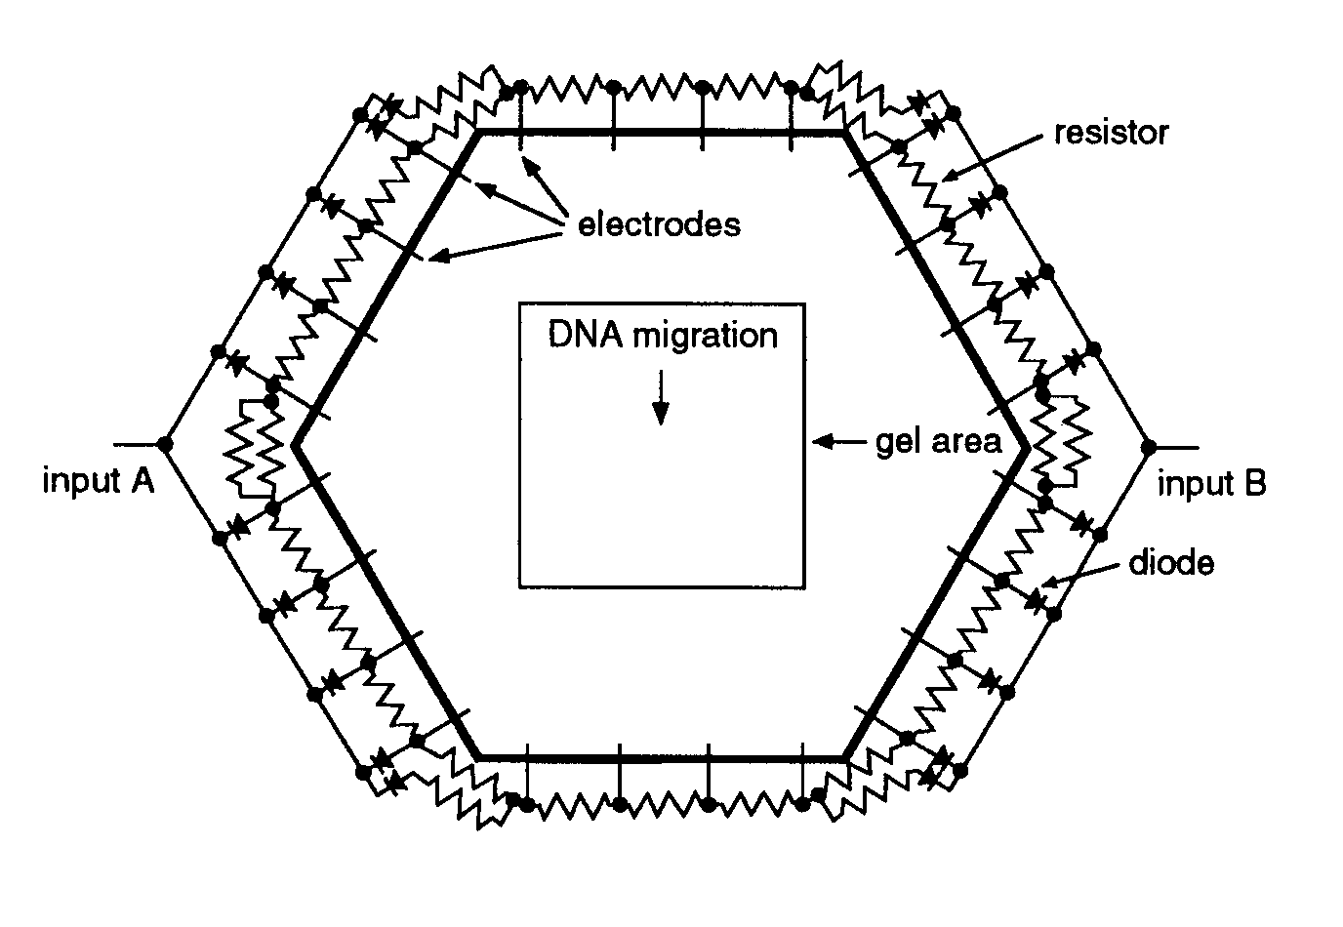
Electroforese em Campo Pulsado
(PFGE)
Electroforese capilar

Slide 14
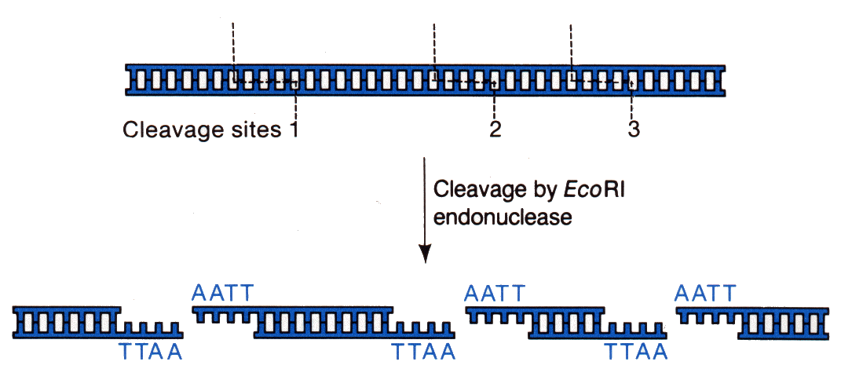
Reacção de restrição

Slide 15
MONTAR UMA
REACÇÃO DE RESTRIÇÃO
Instabilidade térmica
Concentração de glicerol
Tampão de reacção
Actividade enzimática:
  1UI digere 1µg de DNA em 50µl em uma hora
  conformação e pureza do DNA
  utilizar 2-3 x mais enzima
  volume total > 50µl
  Homogeneizar por pipetagem
  Verificar a temperatura de reacção

Slide 16
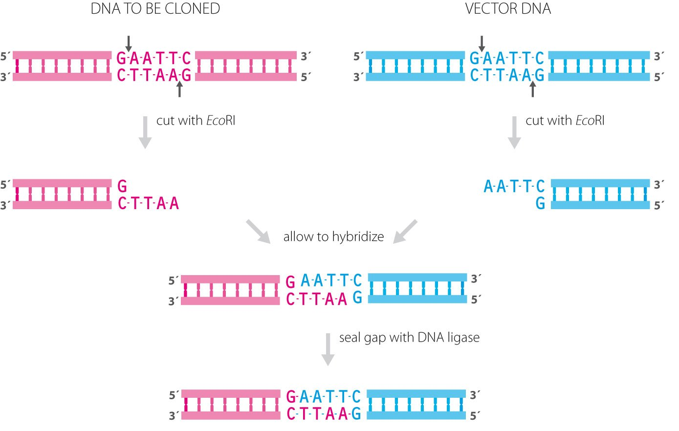
Clonagem

Slide 17
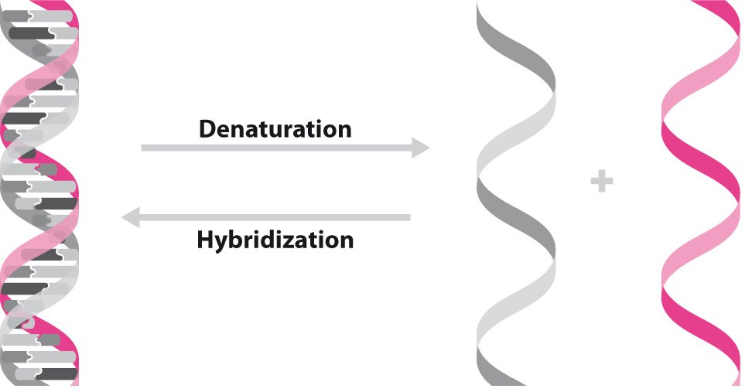
Hibridização

Slide 18
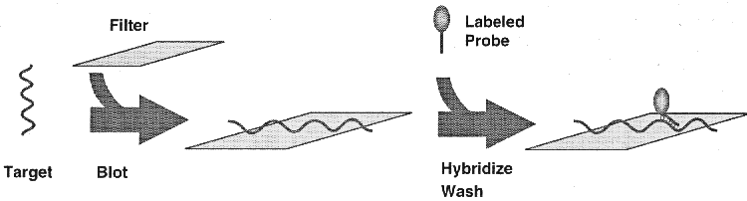
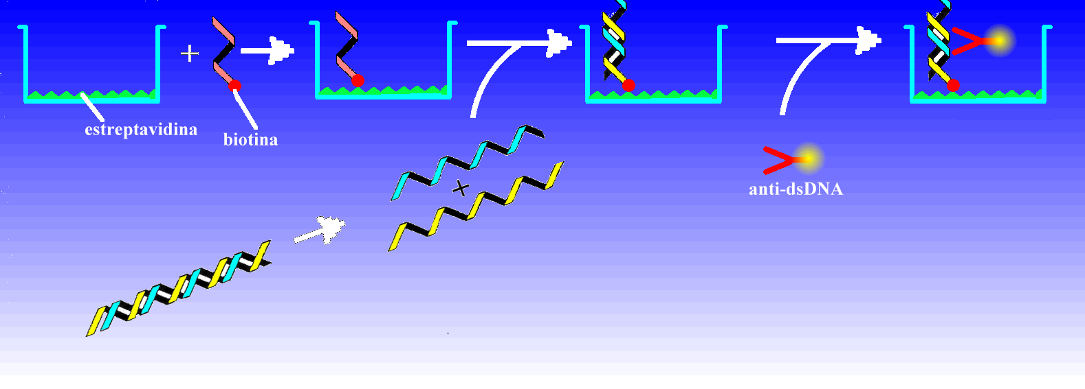
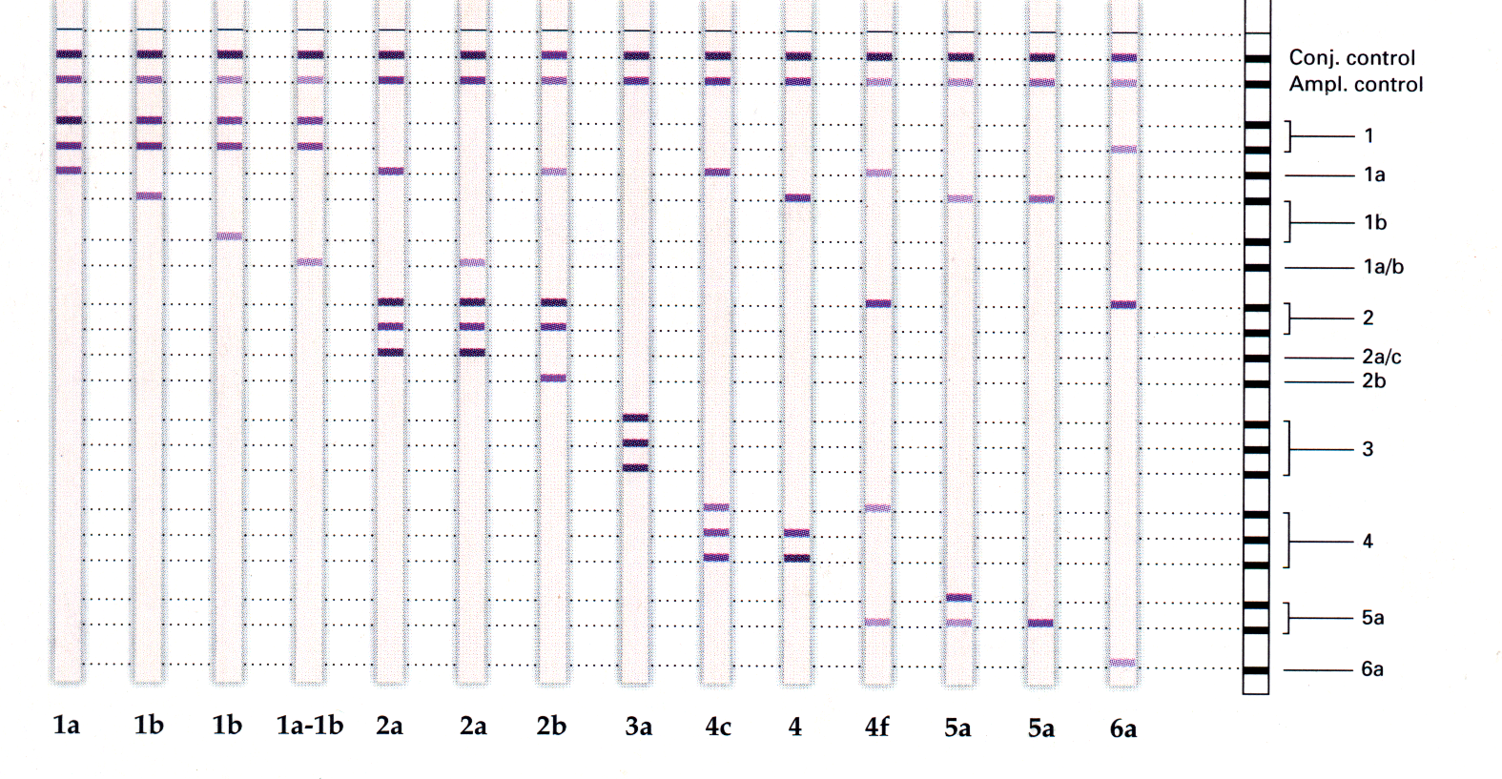
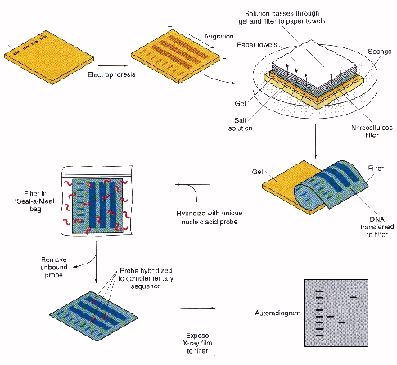
Dot-Blot
DEIA
INNO-LIPA
Southern-Blot

Slide 19
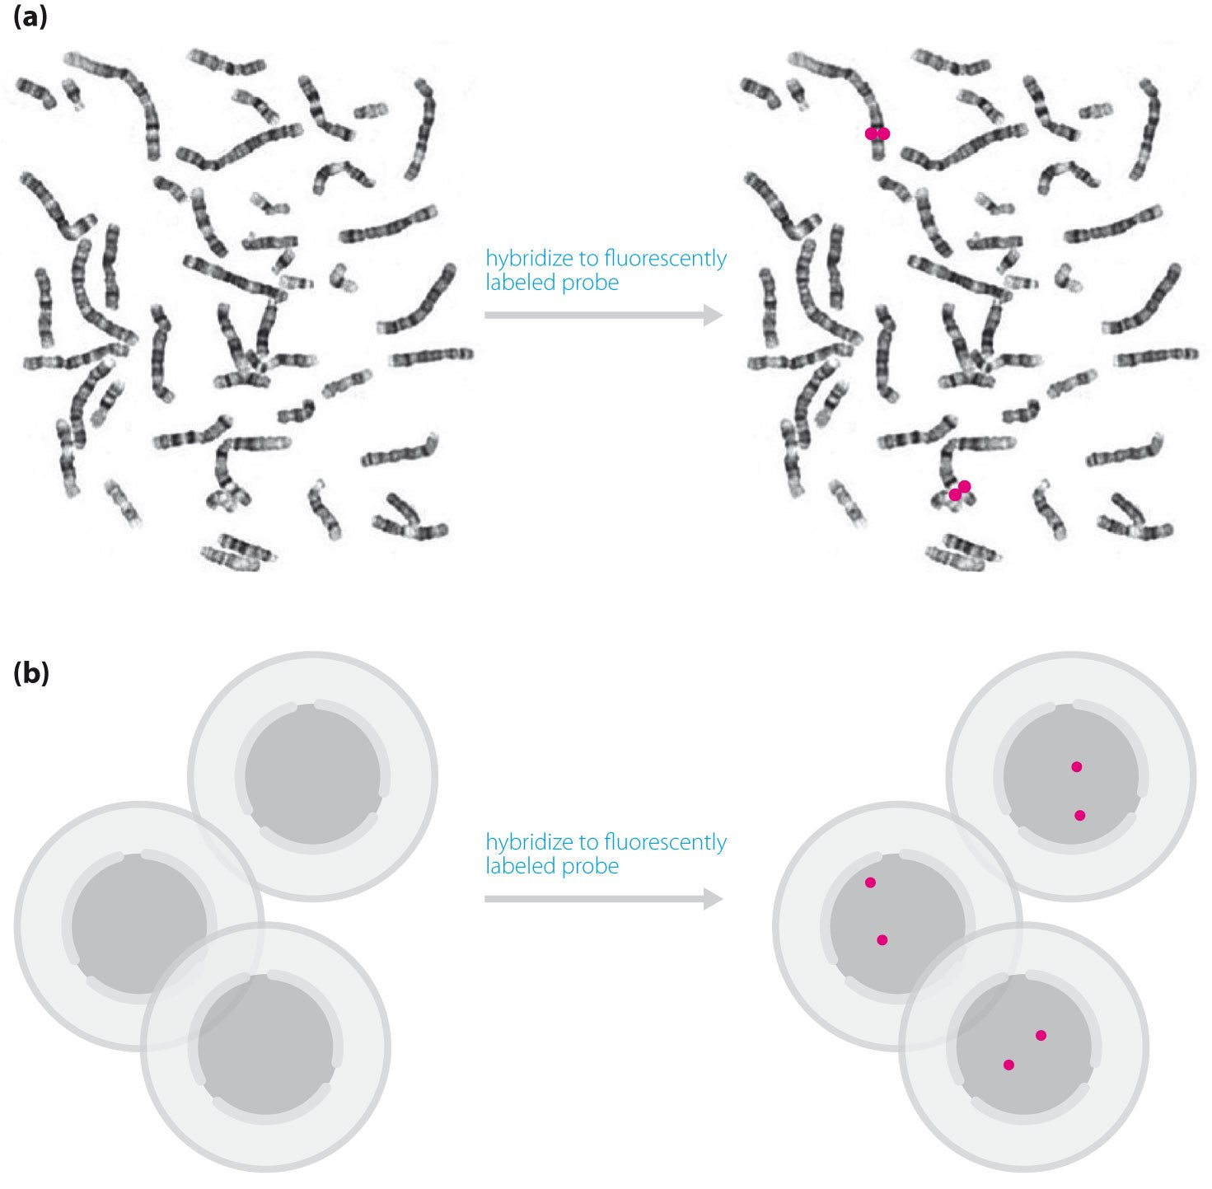
Citogenetica

Slide 20
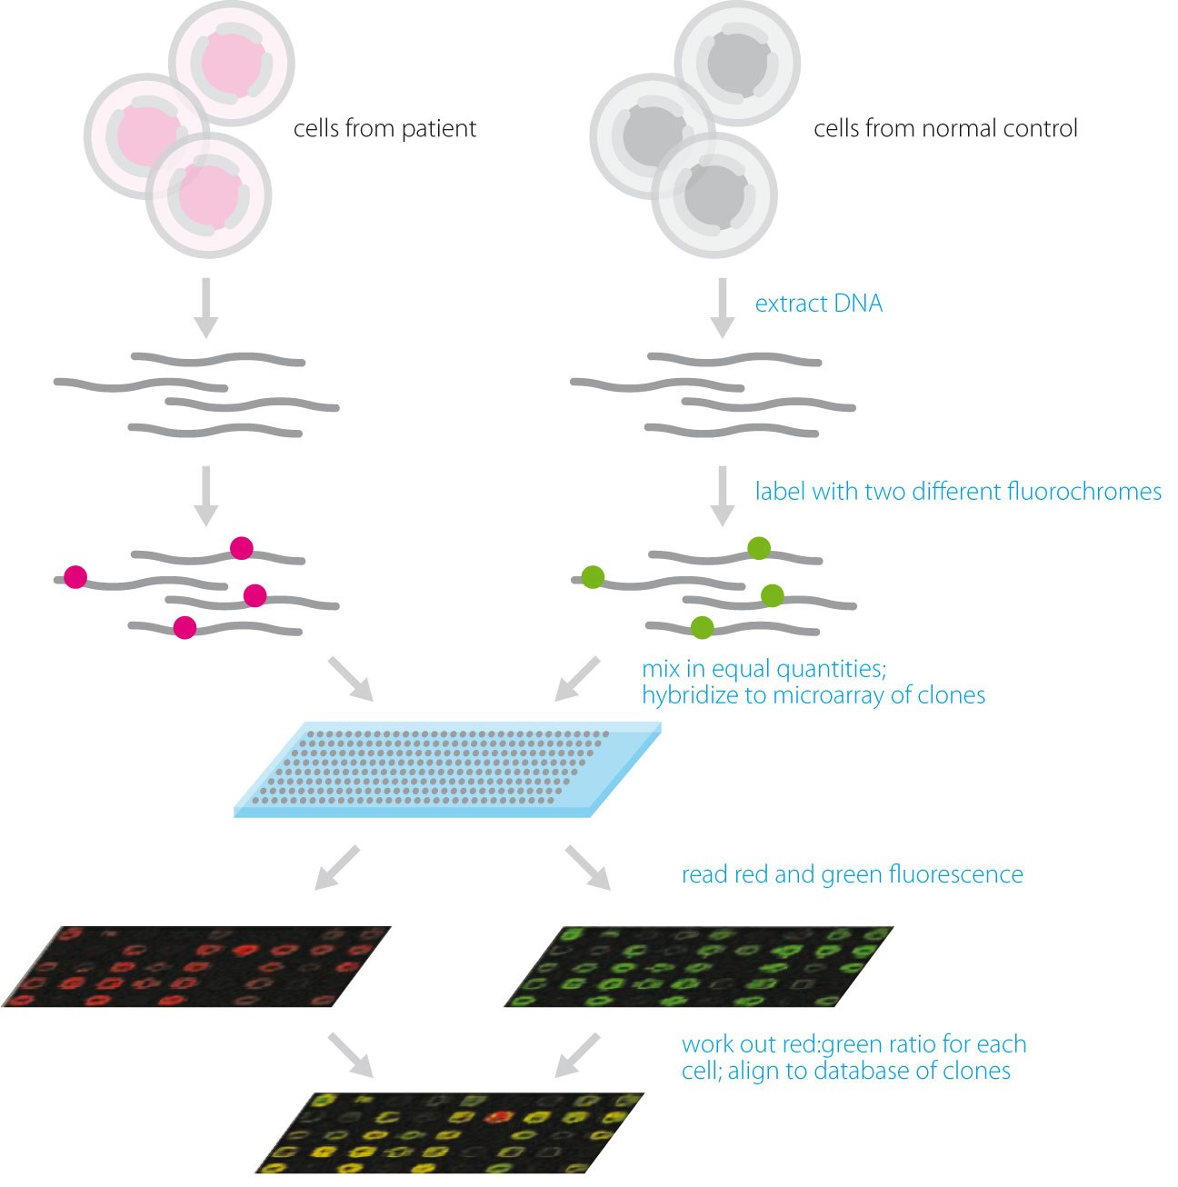
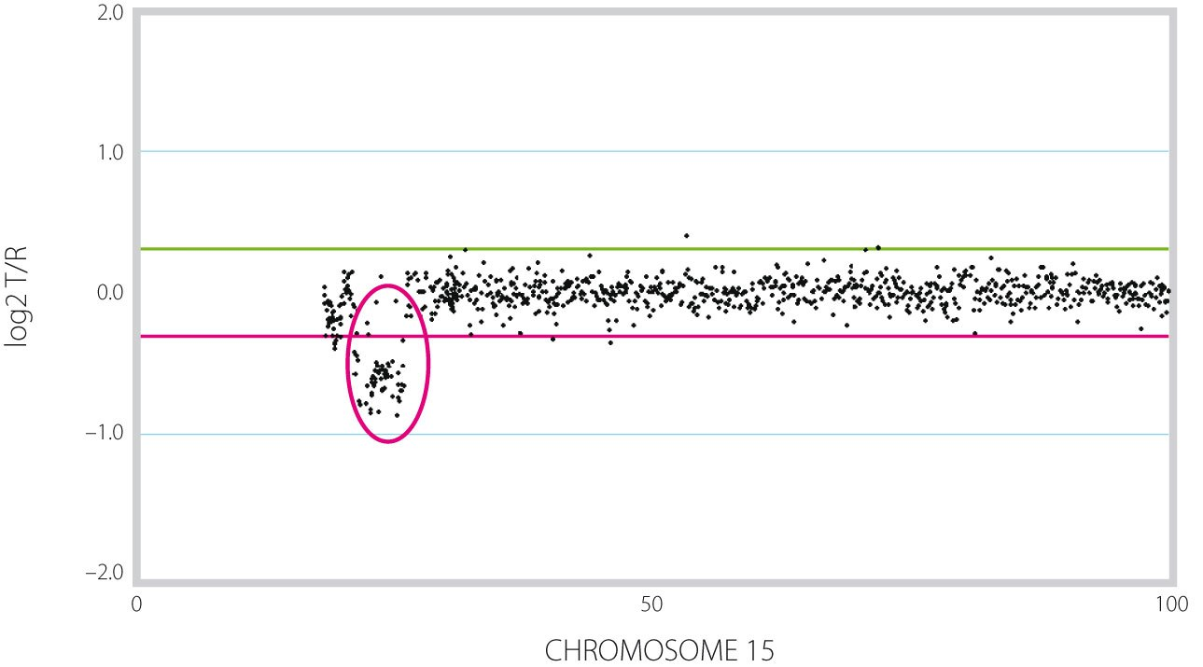
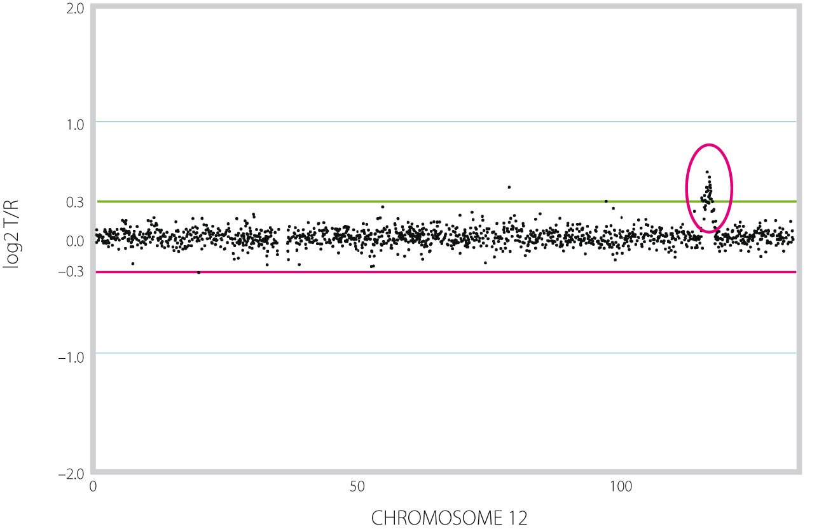
Micro-chips
Array-CGH
CGH = comparative genomic hybridization

Slide 21
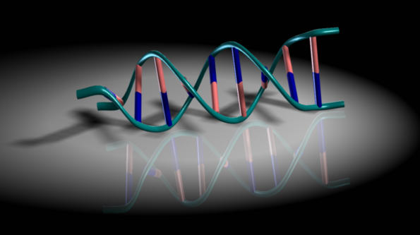
A Sequenciação em Análises Clínicas

Slide 22
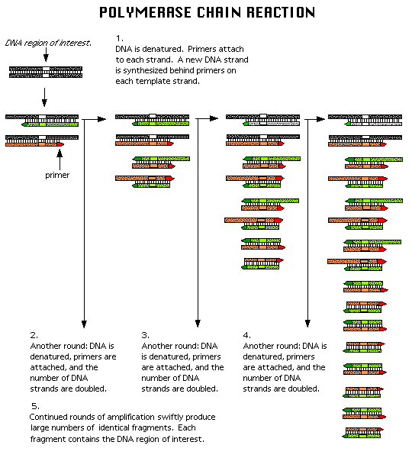
Polymerase Chain Reaction

Slide 23
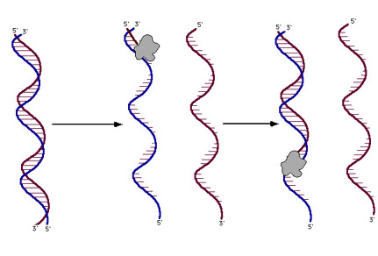
DNA Sequencing Reactions
The DNA sequencing rxn is similar to the PCR rxn.
The rxn mix includes the template DNA, Taq polymerase, dNTPs, ddNTPs, and a primer: a small piece of single-stranded DNA 20-30 nt long that hybridizes to one strand of the template DNA.
The rxn is intitiated by heating until the two strands of DNA separate, then the primers anneals to the complementary template strand, and DNA polymerase elongates the primer.

Slide 24
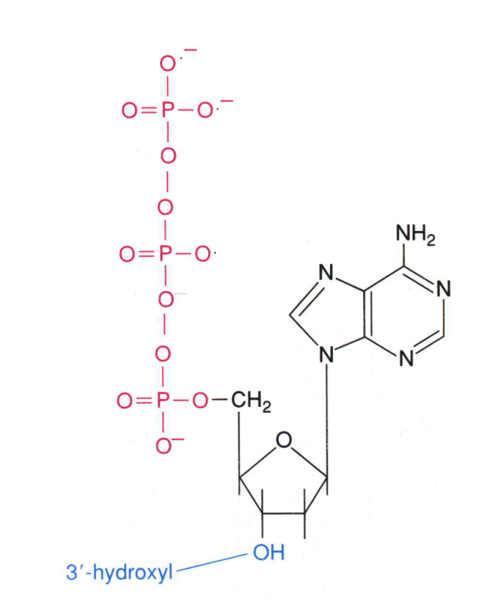
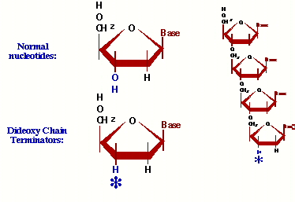
Dideoxynucleotides
In automated sequencing ddNTPs are fluorescently tagged with 1 of 4 dyes that emit a specific wavelength of light when excited by a laser.
ddNTPs are chain terminators because there is no 3’ hydroxy group to facilitate the elongation of the growing DNA strand.
In the sequencing rxn there is a higher concentration of dNTPs than ddNTPs.

Slide 25
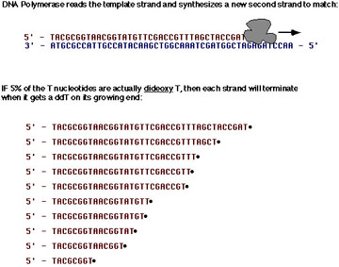
DNA Replication in the Presence of ddNTPs
DNA replication in the presence of both dNTPs and ddNTPs will terminate the growing DNA strand at each base.
In the presence of 5% ddTTPs and 95% dTTPs Taq polymerase will incorporate a terminating ddTTP at each ‘T’ position in the growing DNA strand.
Note: DNA is replicated in the 5’ to 3’ direction.

Slide 26
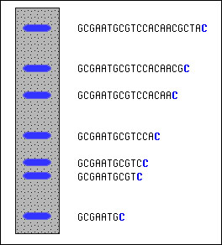
Gel Electrophoresis DNA Fragment Size Determination
DNA is negatively charged because of the Phosphate groups that make up the DNA Phosphate backbone.
Gel Electrophoresis separates DNA by fragment size. The larger the DNA piece the slower it will progress through the gel matrix toward the positive cathode. Conversely, the smaller the DNA fragment, the faster it will travel through the gel.

Slide 27
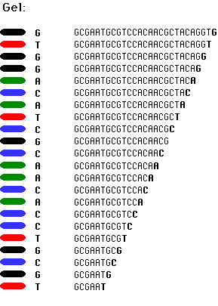
Putting It All Together
Using gel electrophoresis to separate each DNA fragment that differs by a single nucleotide will band each fluorescently tagged terminating ddNTP producing a sequencing read.
The gel is read from the bottom up, from 5’ to 3’, from smallest to largest DNA fragment.

Slide 28
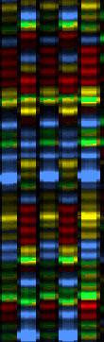
Raw Automated Sequencing Data
A 5 lane example of raw automated sequencing data.
Green: ddATP
Red: ddTTP
Yellow: ddGTP
Blue: ddCTP
Animação
Demo ABI

Slide 29
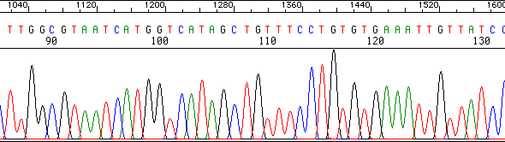
Analyzed Raw Data
In addition to nucleotide sequence text files the automated sequencer also provides trace diagrams.
Trace diagrams are analyzed by base calling programs that use dynamic programming to match predicted and occurring peak intensity and peak location.
Base calling programs predict nucleotide locations in sequencing reads where data anomalies occur. Such as multiple peaks at one nucleotide location, spread out peaks, low intensity peaks.

Slide 30
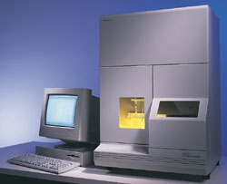
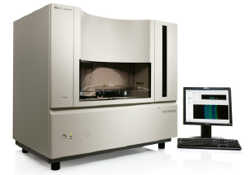
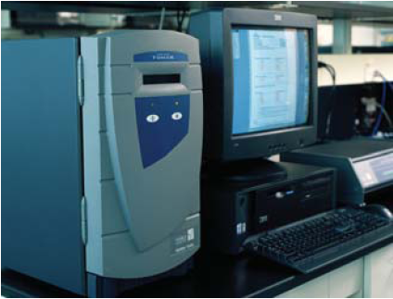
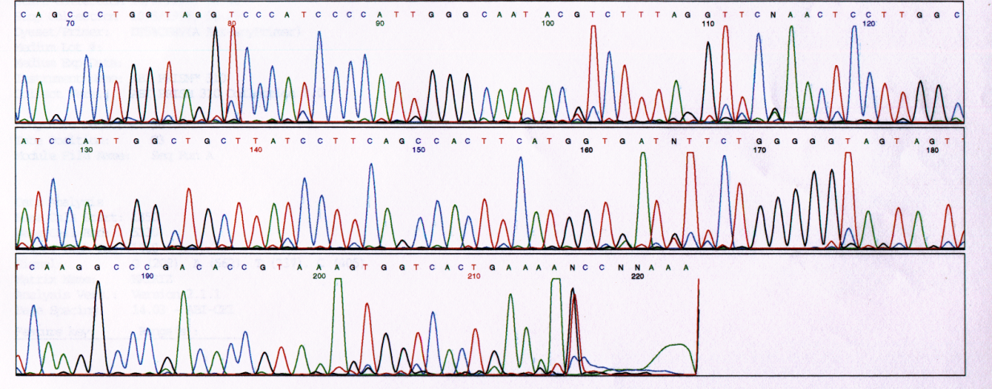
Equipamentos para sanger sequencing

Slide 31
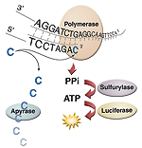
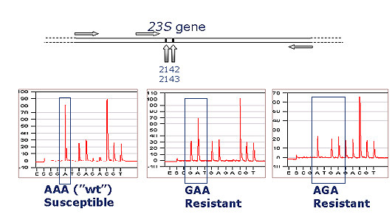
Pirosequenciação

Slide 32
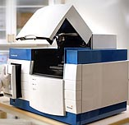





Equipamentos para pirosequenciação

Slide 33


SOLID sequencing

Slide 34
Sequencing Strategies
Map-Based Assembly:
  Create a detailed complete fragment map
  Time-consuming and expensive
  Provides scaffold for assembly
  Original strategy of Human Genome Project
Shotgun:
  Quick, highly redundant – requires 7-9X coverage for sequencing reads of 500-750bp. This means that for the Human Genome of 3 billion bp, 21-27 billion bases need to be sequence to provide adequate fragment overlap.
  Computationally intensive
  Troubles with repetitive DNA
  Original strategy of Celera Genomics

Slide 35

Map-Based Assembly
contigs

Slide 36

Shotgun Sequencing: Assembly of Random Sequence Fragments
To sequence a Bacterial Artificial Chromosome (100-300Kb), millions of copies are sheared randomly, inserted into plasmids, and then sequenced. If enough fragments are sequenced, it will be possible to reconstruct the BAC based on overlapping fragments.

Slide 37
Whole Genome Shotgun Sequencing
genome
cut many times at random
plasmids (2 – 10 Kbp)
forward-reverse linked reads
known dist
cosmids (40 Kbp)
~500 bp
~500 bp

Slide 38
Challenges with Shotgun Sequencing
Sequencing errors
  ~1-2% of bases are wrong
Repeats

Slide 39
ARACHNE:
Whole Genome Shotgun Assembly
1. Find overlapping reads
2. Merge good pairs of reads into longer contigs
3. Link contigs to form supercontigs
4. Derive consensus sequence
..ACGATTACAATAGGTT..
http://www-genome.wi.mit.edu/wga/

Slide 40
Gene Recognition
Predict the segments that code for protein
Predict the resulting protein sequence

Slide 41
Cross-species Comparative Annotation
Ab initio prediction by looking at two orthologs simultaneously

Slide 42
Comparing Human and Mouse DNA
Most human genes have mouse orthologs
Coding exons usually correspond 1-1
Coding sequence similarity ~ 85%

Slide 43
GLASS: GLobal Alignment SyStem
Fast global alignment of long sequences
Align divergent sequences with ordered islands of strong homology

Slide 44

The ROSETTA Method
Input: orthologous human & mouse sequence
Repeat masking
GLASS global alignment
Throw away regions of weak alignment
Find genes in both sequences using coincidence of exon signals

Slide 45
Example: A Human/Mouse Ortholog
Alignment:
Detection
Human and mouse PCNA
(Proliferating Cell Nuclear Antigene) genes

Slide 46
Gene Transcriptional Regulation
-300
0
GRE
AP2
AP2
MRE
MRE
AP2
AP1
MRE
SP1
TATA
GENE
promoter of methallothionein
+
enhancer
promoter
Predict location of transcription factor binding sites, and composite regulatory elements

